Slide 1

FACIAL EMOTION DETECTION USING NEURAL NETWORK
Project Supervisor – Dr. Akash Rajak

Slide 2


Team members 1. Anil Kumar singh (2000290140018) 2. akash kumar singh (2000290140011)

Slide 3

introduction
Facial expressions play a significant role in human dialogue. The machine learning algorithm uses some open features to model the face. In this work, convolutional neural networks (CNNs) were developed to identify the expression of facial emotions. Also, Machine Learning techniques, Deep Learning models, and Neural Network algorithms are used for emotion recognition. This work will be proposed as an effective way to detect anger, contempt, disgust, fear, happiness, sadness, and surprise.

Slide 4

introduction
Facial expressions play an important role in the nonverbal communication that takes place in a person’s inner emotions that are reflected on his or her face. This work has been used the Viola-Jones algorithm to detect the eye and lips region from a face and then with the help of the neural network.

Slide 5
Hardware Requirements / Hardware Used
Central Processing Unit (CPU) - Intel Core i5 6th gen
or AMD processor equivalent
RAM - 8 GB minimum, 16 GB or higher is recommended.
Graphics Processing Unit (GPU) - NVIDIA GeForce GTX 960 or higher
Inbuilt Camera or Webcam Support
Operating System (OS) - — Ubuntu or Microsoft Windows 10

Slide 6

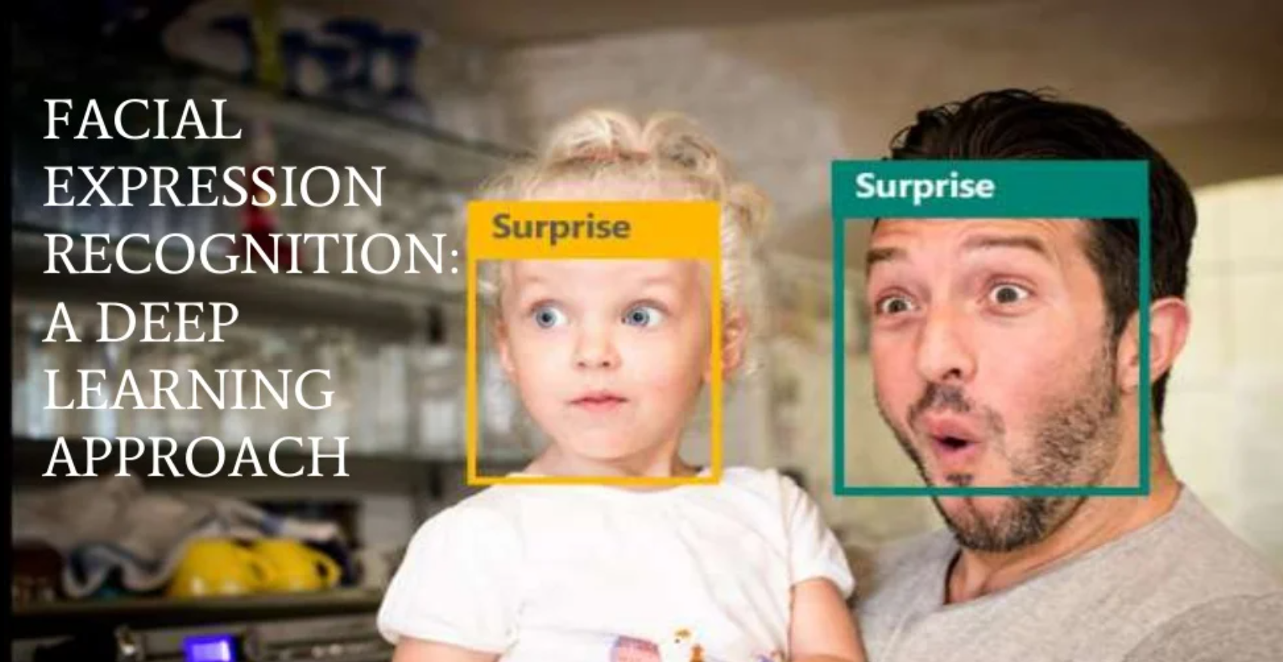
Title:

Slide 7
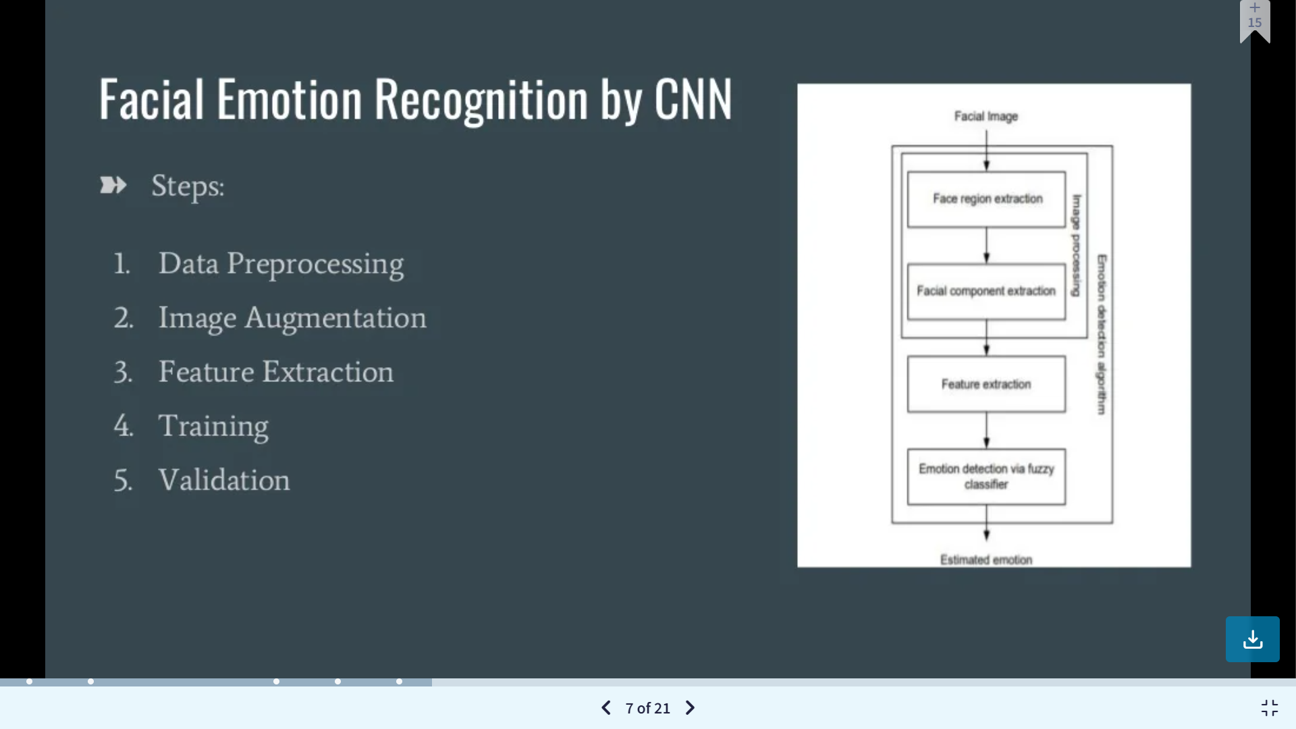

Slide 8

SYSTEM ARCHITECTURE
8
Capture Image
Face detected
Add a Footer
Display of emotion for each face
Classification
Feature Extraction

Slide 9

Technologies / Software Requirements
Python 3
Library - open cv
Mood Recognition System
Dataset from Kaggle

Slide 10
Conclusion
Finally, we can say that our mood almost always dictates our action, and our software will help in detecting the person’s mood so that person can relax and make more informed decisions

Slide 11
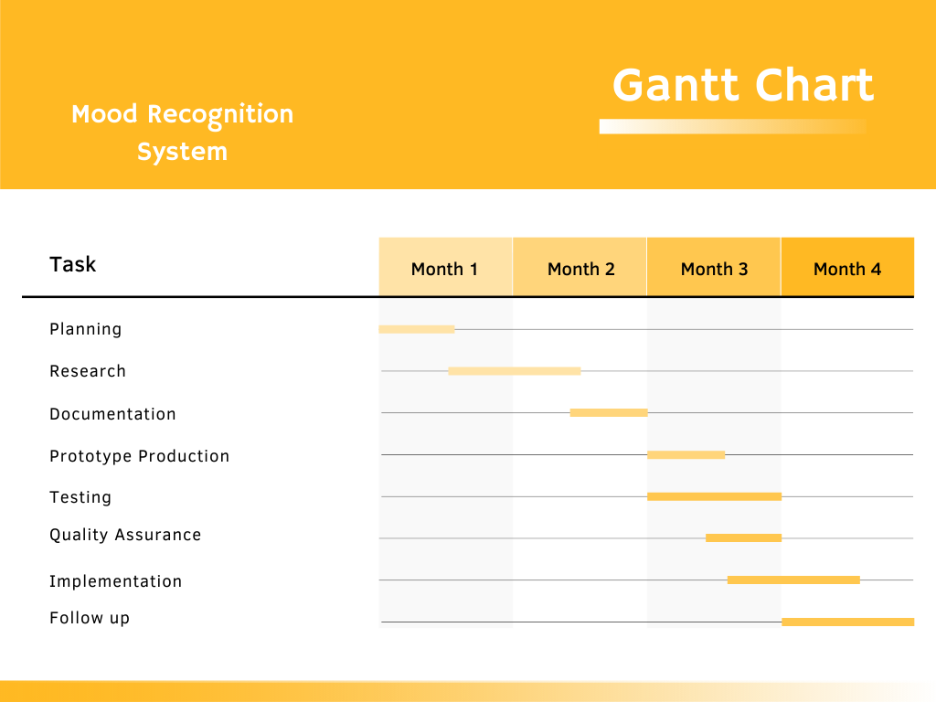
Gantt Chart
Febrruary
March
April
May

Slide 12
THANK YOU

